Slide 1
Lecture 4: Monte Carlo methods

Slide 2
Monte Carlo
Monte Carlo methods (or Monte Carlo experiments) are a class of computational algorithms that rely on repeated random sampling to compute their results
Monte Carlo methods for random number generation
Metropolis-Hastings algorithm
Gibbs sampler
Monte Carlo methods in statistical inference
Estimating Integrals
Variance estimation
Variance reduction
Importance sampling
Control variates

Slide 3
Markov Chain Monte Carlo (MCMC)
Motivation: We already know methods to generate
univariate distributions (inverse CDF, acceptance/rejection)
multivariate normal
but what about general multivariate distribution?
MCMC allows to do that!

Slide 4
Short about bayesian inference
Suppose that a dataset D was obtained by sampling from some unknown distribution f(x|θ). How to find θ?
Frequentists : θ is unknown parameter, compose likelihood p(D|θ) function, find maximum → get θ
Bayesians: θ is a random variable, it has prior probability p(θ) (which reflects our guesses about possible θ and their probabilities, before data collected)
After data is collected, the Bayes’ theorem says:

Slide 5
Short about bayesian inference
Task: knowing p(D|θ) and p(θ), generate random samples from p(θ|D).
Problems:
As previously, it is multivariate distribution of general type
Integral is often difficult or impossible to compute
MCMC:
First problem is solved
Integral computation will not be needed in MCMC

Slide 6
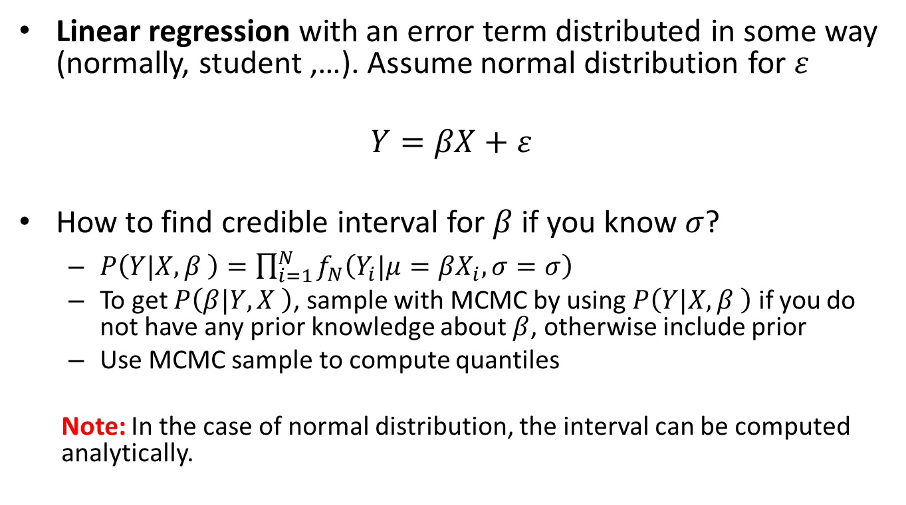
MCMC: Example
Linear regression with an error term distributed in some way (normally, student ,…). Assume normal distribution for $ε$
$$Y=βX+ε$$
How to find credible interval for $β$ if you know $σ$?
$P\left(Y|X,β \right)=\prod_{i=1}^{N}{f_{N}\left(Y_{i}|μ=βX_{i},σ=σ\right)}$
To get $P\left(β|Y,X \right)$, sample with MCMC by using $P\left(Y|X,β \right)$ if you do not have any prior knowledge about $β$, otherwise include prior
Use MCMC sample to compute quantiles
Note: In the case of normal distribution, the interval can be computed analytically.

Slide 7
Markov chains
Markov chain is a sequence X₀, X₁,… of random variables such that next value depends only on the previous one
is called transition kernel, assume it does not depend on t
Theorem Under certain conditions, Markov chain will converge to the stationary distribution φ ( not sensitive to X₀ ), i.e.
First k-1 samples are normally discarded, they are called burn-in period

Slide 8
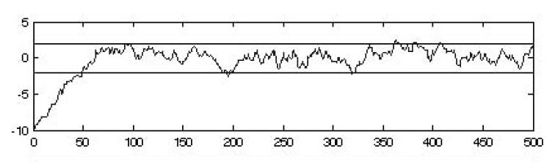
Example: univariate X

Slide 9
Metropolis-Hastings algorithm
Given:
PDF π(x) that we need to obtain samples from
Proposal distribution q(. I X_{t} ) – it may have almost any, but regular form
Ex: q(. I X_{t} ) is a normal distr. with mean X_{t} and fixed cov. matr.
“Regular form”:
It’s enough that the proposal distr. has the same support with nonzero density as π

Slide 10
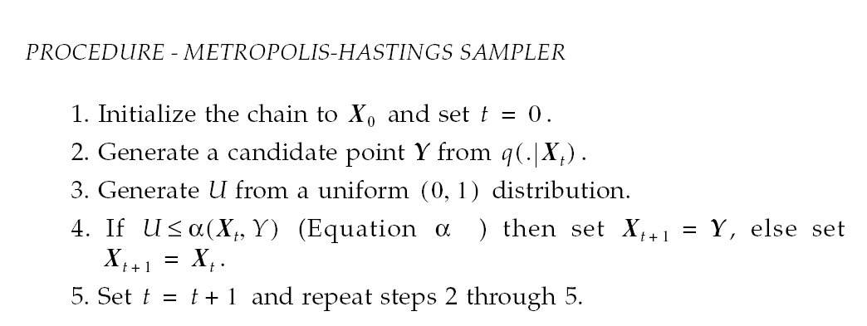
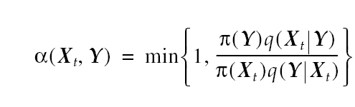
Metropolis-Hastings algorithm
Equation α:

Slide 11
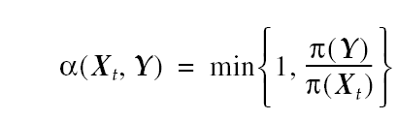
Metropolis-Hastings algorithm
Comments:
The chain will converge to π(x)
In Bayesian inference the integral term will be cancelled, look the formula for α
Observe, that in some cases the chain does not move
The variables in the obtained sample are dependent
If , the formula transforms to Random-walk Monte Carlo

Slide 12
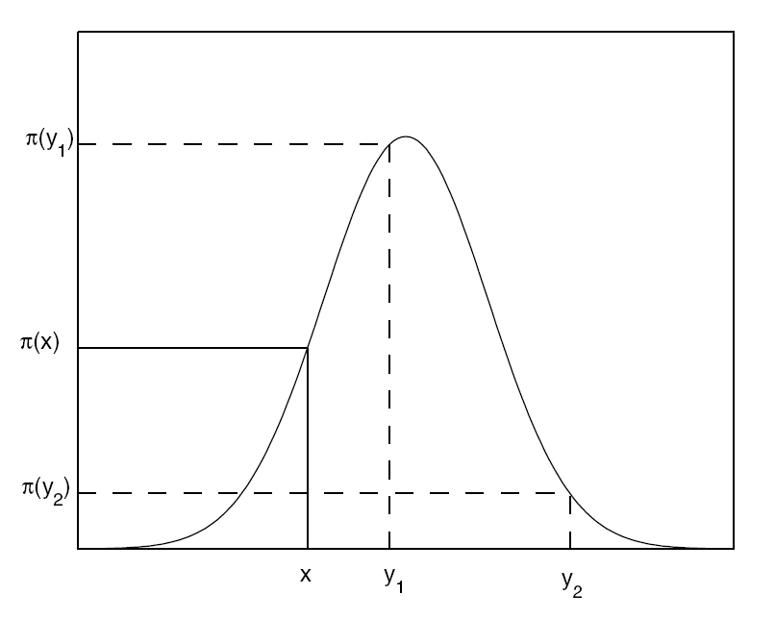
Choice of proposal distribution
In Random-Walk Monte Carlo,
If , the chain moves to next point, otherwise moved with some probability.

Slide 13
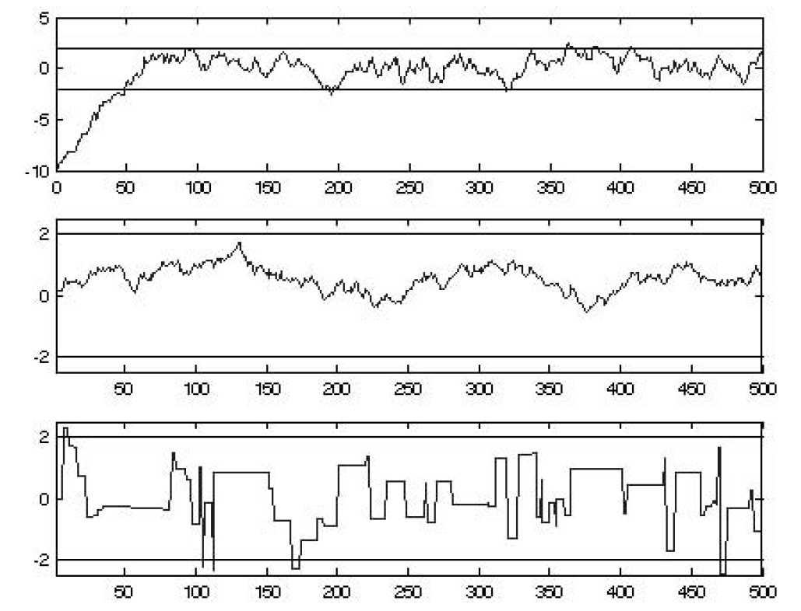
Choice of proposal distribution
Proposal density should be selected with care!
Example: q is normal with σ=0.5 0.1 10

Slide 14
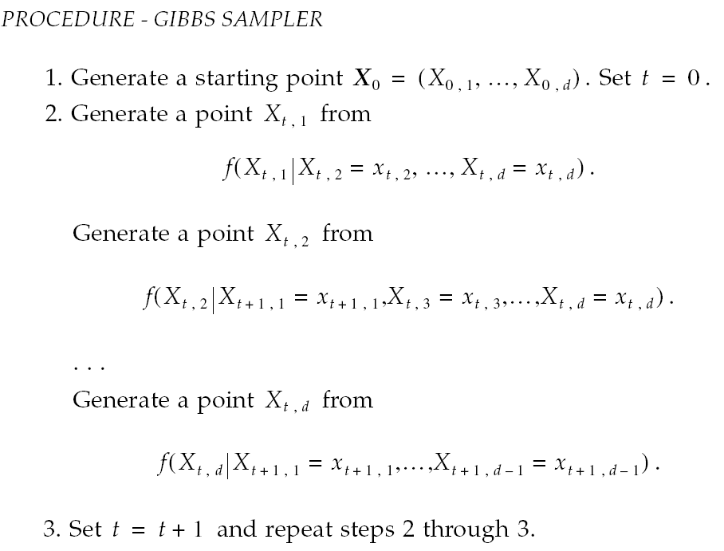
Gibbs sampler
Another way to generate multivariate random numbers
Uses conditional distributions → need random number generators that sample from univariate distributions

Slide 15
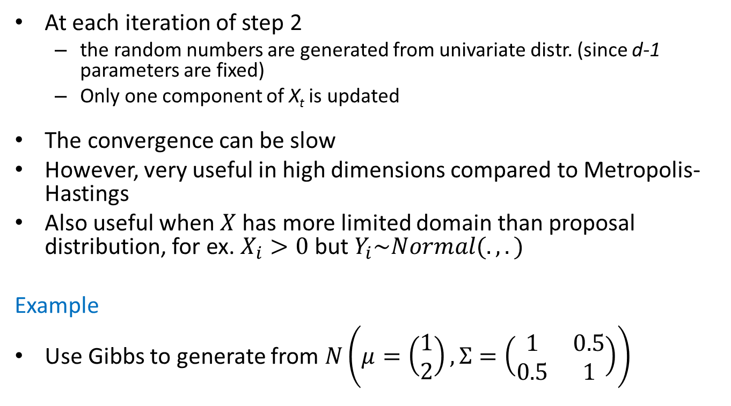
Gibbs sampler
At each iteration of step 2
the random numbers are generated from univariate distr. (since d-1 parameters are fixed)
Only one component of X_{t} is updated
The convergence can be slow
However, very useful in high dimensions compared to Metropolis-Hastings
Also useful when $X$ has more limited domain than proposal distribution, for ex. $X_{i}>0$ but $Y_{i}\sim Normal(.,.)$
Example
Use Gibbs to generate from $N\left(μ=\left(\begin{matrix}1 \\ 2\end{matrix}\right), Σ=\left(\begin{matrix}1 & 0.5 \\ 0.5 & 1\end{matrix}\right)\right)$

Slide 16

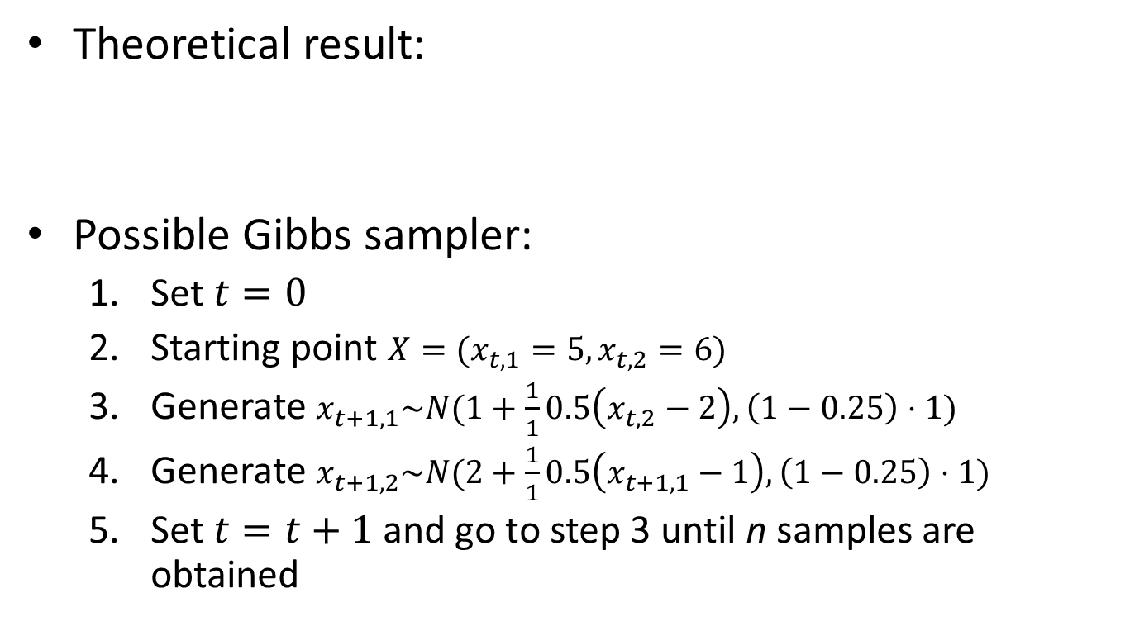
Gibbs sampler
Theoretical result:
Possible Gibbs sampler:
Set $t=0$
Starting point $X=(x_{t,1}=5,x_{t,2}=6)$
Generate $x_{t+1,1}\sim N(1+\frac{1}{1}0.5\left(x_{t,2}−2\right), \left(1−0.25\right)⋅1)$
Generate $x_{t+1,2}\sim N(2+\frac{1}{1}0.5\left(x_{t+1,1}−1\right), \left(1−0.25\right)⋅1)$
Set $t=t+1$ and go to step 3 until n samples are obtained

Slide 17
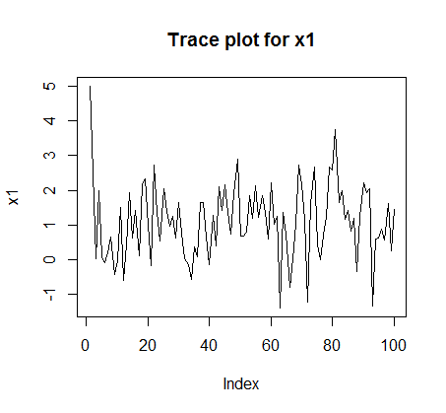
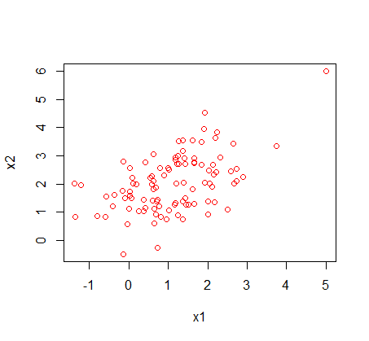
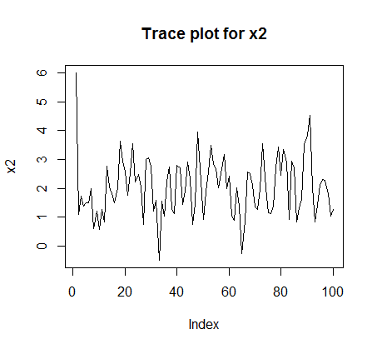
Gibbs sampler
Results, n=100

Slide 18
Convergence monitoring
When should we stop the chain, i.e. when the convergence to the target distr. is attained?
Typically, a sample is generated to make further inference (mean, quantiles etc)

Slide 19





Convergence monitoring
Gelman-Rubin method
Assume, we estimate ν(X)
Generate k sequences of length n with different starting points
Compute between- and within- sequence variances:
Compute overall variance estimate:
Compute Gelman-Rubin factor
If the factor is close to 1, i.e. around 1.0 - 1.2, then the convergence is achieved

Slide 20
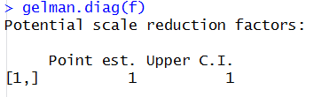
Convergence monitoring
Code
Assume that we have n chains as vectors matrix X (X[,1],..X[,n])
library(coda)
f=mcmc.list()
for (i in 1:n) f[[i]]=as.mcmc(X[,i])
gelman.diag(f)
Should be close to 1!

Slide 21





MC for inference
Estimation of definite integral
If can not estimate in closed form,
Decompose into
such that
Then,
Estimator

Slide 22
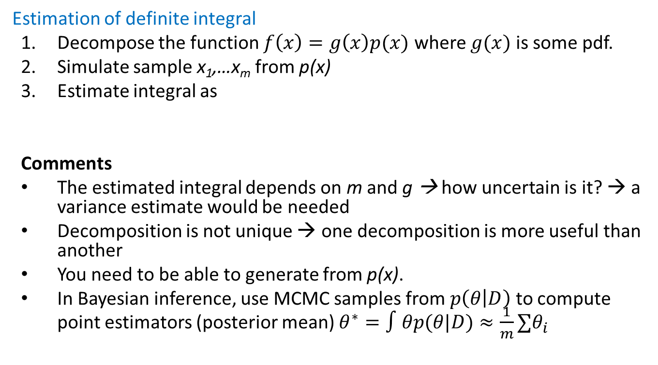
MC for inference
Estimation of definite integral
Decompose the function $f\left(x\right)=g\left(x\right)p(x)$ where $g(x)$ is some pdf.
Simulate sample x₁,…x_{m} from p(x)
Estimate integral as
Comments
The estimated integral depends on m and g → how uncertain is it? → a variance estimate would be needed
Decomposition is not unique → one decomposition is more useful than another
You need to be able to generate from p(x).
In Bayesian inference, use MCMC samples from $p\left(θ | D\right)$ to compute point estimators (posterior mean) $θ^{∗}=∫θp(θ|D)≈\frac{1}{m}∑θ_{i}$

Slide 23

Variance estimation
Variance of integral estimation
However, since x_{i} are correlated in MCMC, this estimator is biased
Instead, take longer chain and use batch means instead of x_{i}

Slide 24
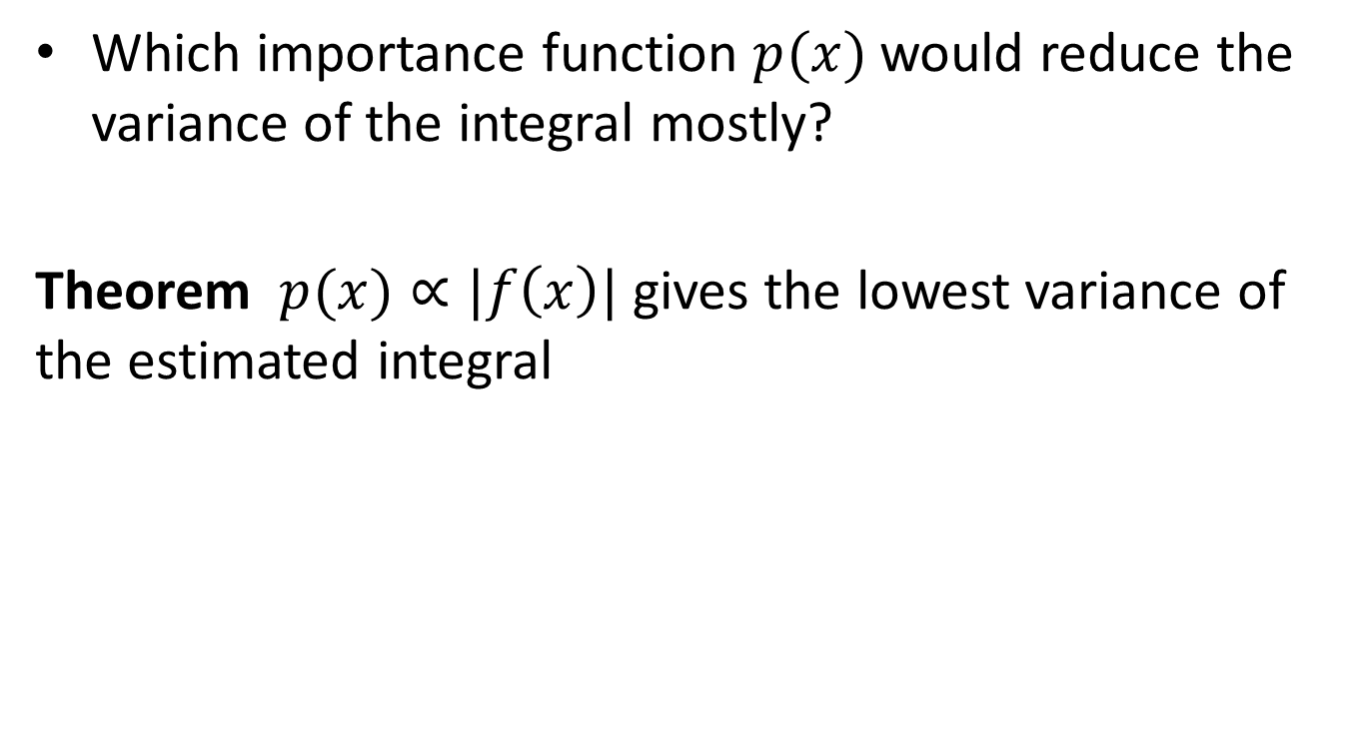
Importance sampling
Which importance function $p(x)$ would reduce the variance of the integral mostly?
Theorem $p(x)∝|f\left(x\right)|$ gives the lowest variance of the estimated integral

Slide 25
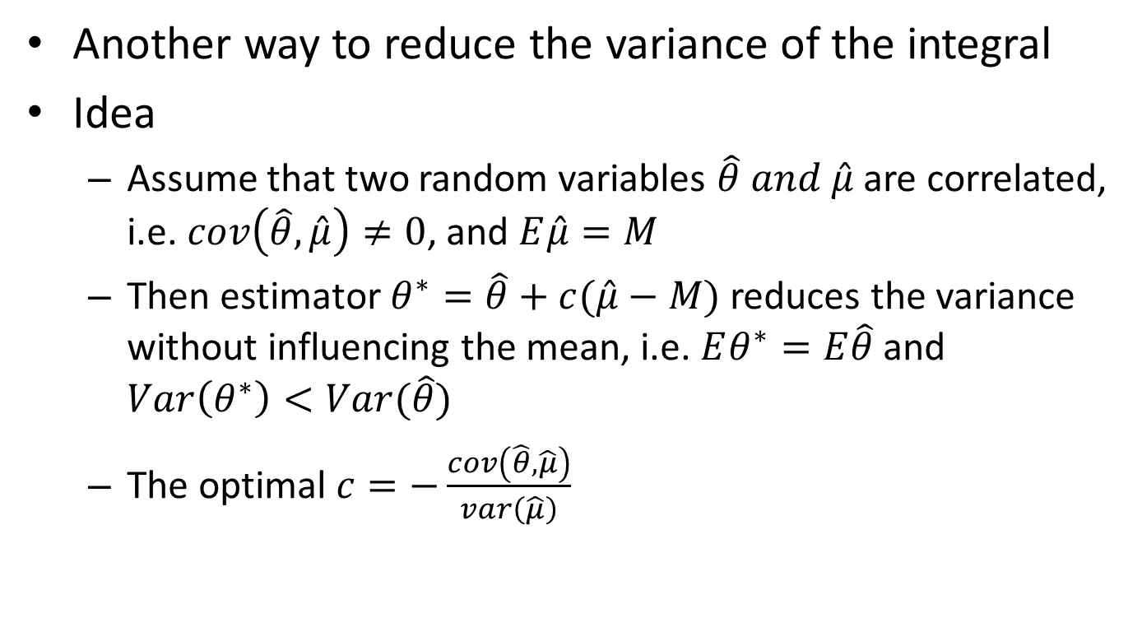
Control variates
Another way to reduce the variance of the integral
Idea
Assume that two random variables $\hat{θ} and \hat{μ}$ are correlated, i.e. $cov\left(\hat{θ},\hat{μ}\right)≠0$, and $E\hat{μ}=M$
Then estimator $θ^{∗}=\hat{θ}+c(\hat{μ}−M)$ reduces the variance without influencing the mean, i.e. $Eθ^{∗}=E\hat{θ}$ and $Var\left(θ^{∗}\right)<Var(\hat{θ})$
The optimal $c=−\frac{cov\left(\hat{θ},\hat{μ}\right)}{var\left(\hat{μ}\right)}$

Slide 26
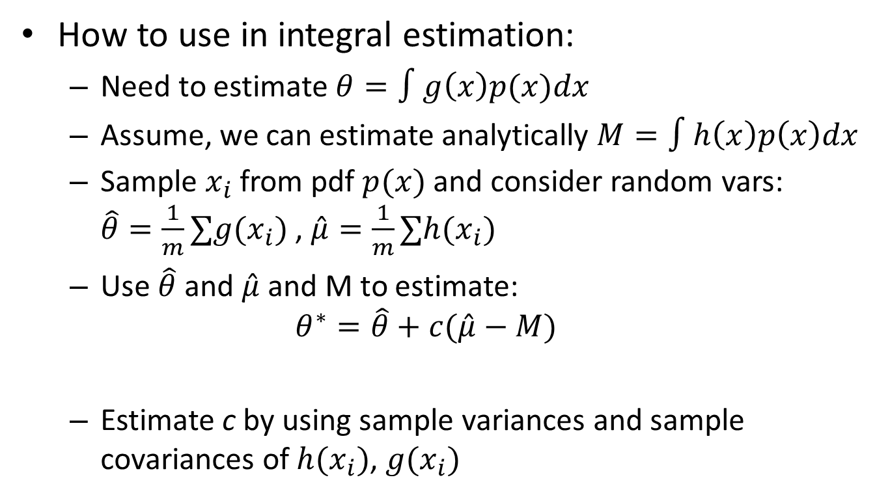
Control variates
How to use in integral estimation:
Need to estimate $θ=∫g\left(x\right)p(x)dx$
Assume, we can estimate analytically $M=∫h\left(x\right)p\left(x\right)dx$
Sample $x_{i}$ from pdf $p(x)$and consider random vars: $\hat{θ}=\frac{1}{m}∑{g(x}_{i})$ , $\hat{μ}=\frac{1}{m}∑{h(x}_{i})$
Use $\hat{θ}$ and $\hat{μ}$ and M to estimate:
$$θ^{∗}=\hat{θ}+c(\hat{μ}−M)$$
Estimate c by using sample variances and sample covariances of ${h(x}_{i})$, ${g(x}_{i})$

Slide 27
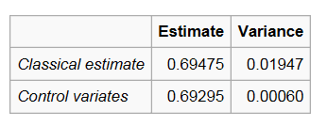
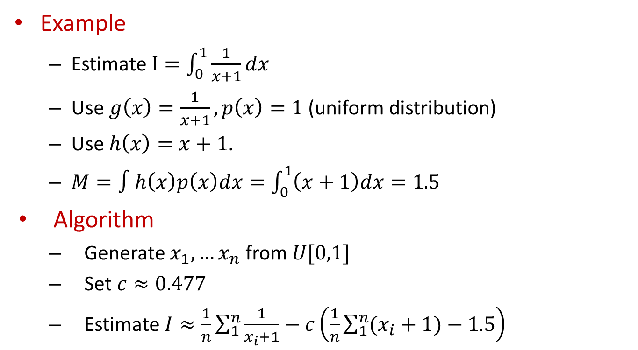
Control variates
Example
Estimate $I=\int_{0}^{1}{\frac{1}{x+1}dx}$
Use $g\left(x\right)=\frac{1}{x+1}, p\left(x\right)=1$ (uniform distribution)
Use $h\left(x\right)=x+1$.
$M=∫h\left(x\right)p\left(x\right)dx=\int_{0}^{1}{\left(x+1\right)dx}=1.5$
Algorithm
Generate $x_{1},…x_{n}$ from $U[0,1]$
Set $c≈0.477$
Estimate $I≈\frac{1}{n}\sum_{1}^{n}{\frac{1}{x_{i}+1}}−c\left(\frac{1}{n}\sum_{1}^{n}{(x_{i}+1)}−1.5\right)$
Source: Wikipedia

